Slide 1
Encinitas Toastmasters
Club Level Speech Contest Training
Prepared by: Kathleen Miller, Contest Chair

Slide 2
Agenda
Speech contest overview
Contestant qualification
Contestants
Functionary roles
Chief Judge
Timers
Judges
Ballot Counters
Notification of Winner
Zoommaster
Q & A

Slide 3
Speech Contest Overview
Clubs have the option of appointing a contestant to the Area contest, by any means they choose. However, if they choose to have a contest, it must follow the Toastmaster International (TI) rules.
ETM club level contest scheduled October 1, 2020
2 Categories:
International 5-7 minute speech on any topic
Club winner or runner up advances to Area contest, then could go to Division, District, and all the way to International world championship contest in August
Humorous 5-7 minute humorous speech
Must be thematic in nature (beginning, middle and end)
Club winner or runner up advances to Area Contest, then could go to Division, District
2020-21 contests through district level will be on Zoom, TBD after that
1st, 2nd and 3rd place will be announced. If first place winner cannot attend the Area contest, 2nd then 3rd place winner are alternates.
Area 11 and 28 plan to hold Area contests together on Saturday October 24

Slide 4
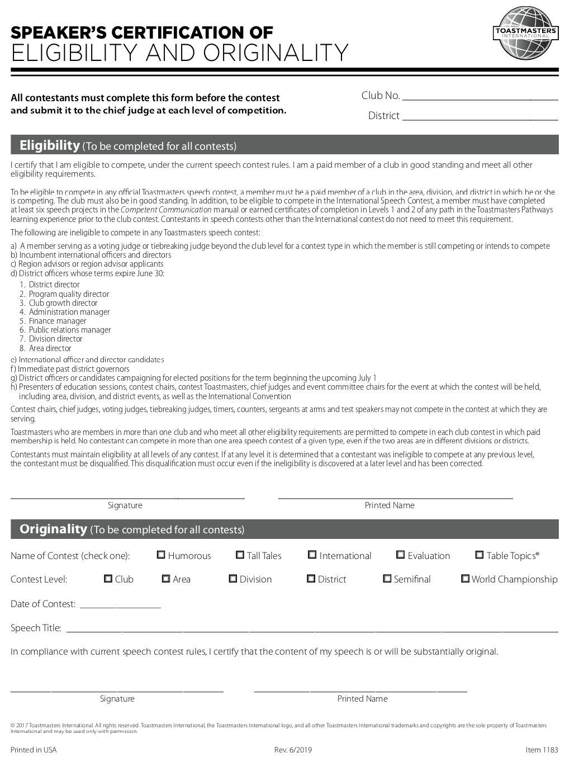
Contestant Qualification
Club in good standing (8 or more paid dues)
Dues paid for contestant
International contestant – Completed 6 speeches in CC or completed L2 in Pathways
Submit form 1183 – Speaker’s Certification of Eligibility and Originality
Optional form 1189 Contestant Bio
Contest chair or chief judge will ensure all speakers are qualified on Toastmasters.org using Leadership Central/Eligibility Assistant prior to the contest

Slide 5
Contestants
Before the contest
Contest chair will brief speakers before the contest
International Contest will go first, followed by Humorous Contest
New rule - Speakers may not reference another contestant speech or another contestant
Contestants must be present at the beginning of their contest, when the contest chair is introduced, or they will be disqualified
5 – 7 minute speech (disqualified if less than 4 min 30 sec or more than 7 min 30 sec)
Review timing cues (5 min – green, 6 min yellow, 7 min red until end of speech)
Speaking order will be determined by a draw
During the Contest
Recommended that contestant pin the timer on Zoom
Contest chair introduces speaker (Contestant’s Name, Speech Title, Speech Title, Contestant’s Name)
Contestant delivers 5 – 7 minute speech
One minute silence for judges to mark ballots
Repeat for remaining contestants in that contest
Zoom breakout session for judges and ballot counters to determine 1st, 2nd, 3rd place
During breakout session, contest chair will interview contestants in front of audience

Slide 6
Chief Judge
Before the contest
Chief judge will recruit 3-5 voting judges (preferably kept anonymous)
Chief judge will brief voting judges, ballot counters and timers before the contest
This may be done days before or right before the contest
Get phone number, email of all functionaries and agree on primary communication method
During the Contest
Contest chair introduces speaker (Contestant’s Name, Speech Title, Speech Title, Contestant’s Name)
Contestant delivers 5 – 7 minute speech
Contestant responsible for their Zoom working and good internet connection
If short technical glitch, chief judge has option to give few additional seconds to speaker
One minute silence for judges to mark ballots
Chief judge will serve as tiebreaking judge if needed, so should complete tiebreaking ballot
Repeat for remaining contestants in that contest
During the Contest Breakout Session
Zoom breakout session for judges, ballot counters to determine 1st, 2nd, 3rd place
Timers report determines if any disqualified due to time
Can challenge if speech not original
If any issues, can ask Contest Chair to join them in breakout room to discuss

Slide 7
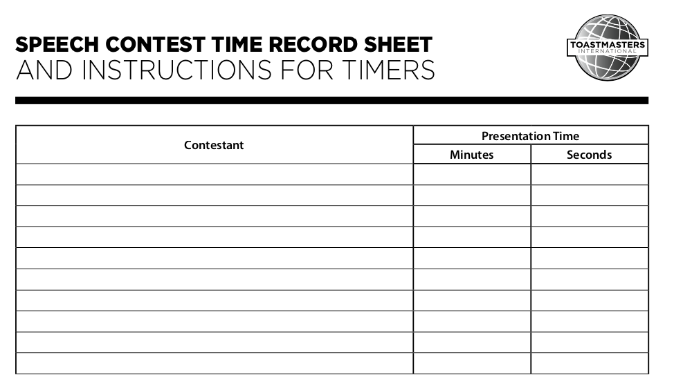
Timers
Green
Green
Green
Review timing cues with speakers before contest
Timers should have word written on card in addition to color
Timing cards preferred to background which may have glitches
Timing starts when contestant starts verbal or nonverbal communication with the audience
5 min – green card (keep holding up) 6 min yellow card (keep holding up) 7 min red card (keep holding up until end of speech)
One timer shows cards while timing, while the other records official time
Timer records the time on form 1175 Time Record Sheet and sends to chief judge
5 – 7 minute speech (disqualified if less than 4 min 30 sec or more than 7 min 30 sec)
If any timing discrepancy, discuss with chief judge in Zoom breakout session (send chat to Zoommaster to ask to join breakout room). Otherwise, the timers may stay in the main meeting.

Slide 8
Judges
Chief judge will brief voting judges, ballot counter and timers before the contest
At least 3 voting judges for club contest recommended (anonymous to contestants preferred)
Chief judge may serve as tiebreaking judge if needed, in lieu of a separate tiebreaking judge
Voting judges get ballots:
1172 – International Speech Contest Judge’s Guide and Ballot
1191 – Humorous Speech Contest Judge’s Guide and Ballot
One minute silence for judges to mark ballots after each speech
Voting judges send their ballots to the ballot counter. Tiebreaking judge sends to chief judge.
Zoom breakout session for judges, ballot counters to determine 1st, 2nd, 3rd place
Judges are to be objective and it is strongly recommended they use the criteria on the ballot, which can be adjusted as they hear different speakers. In the end, their job is to vote for who delivered the best speech that day in that contest.
Judges will make their decision without considering if speech qualified based upon time
Judges select 1st, 2nd, 3rd choice, sign and print names on ballot (no ties on individual ballot)
Send Judge’s Official Ballot (below dotted line) to ballot counters and chief judge

Slide 9
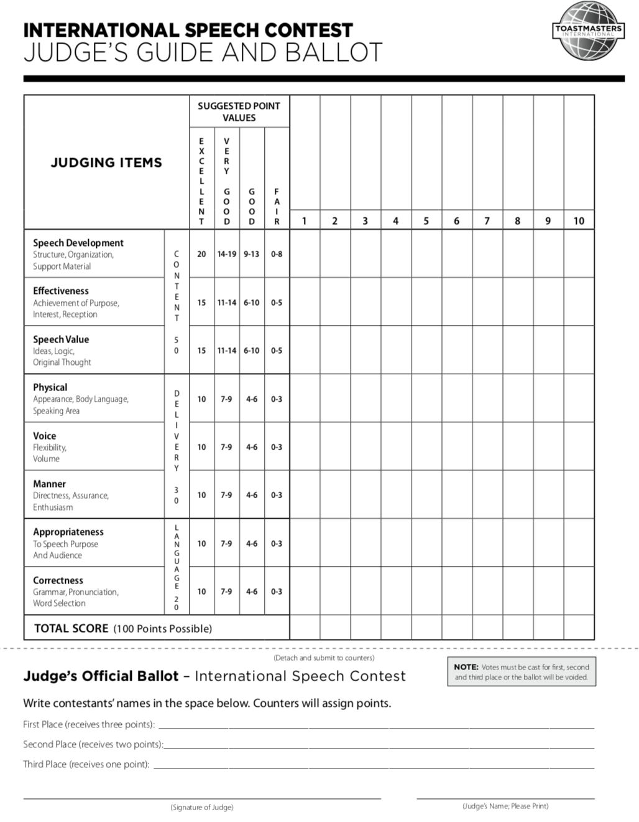
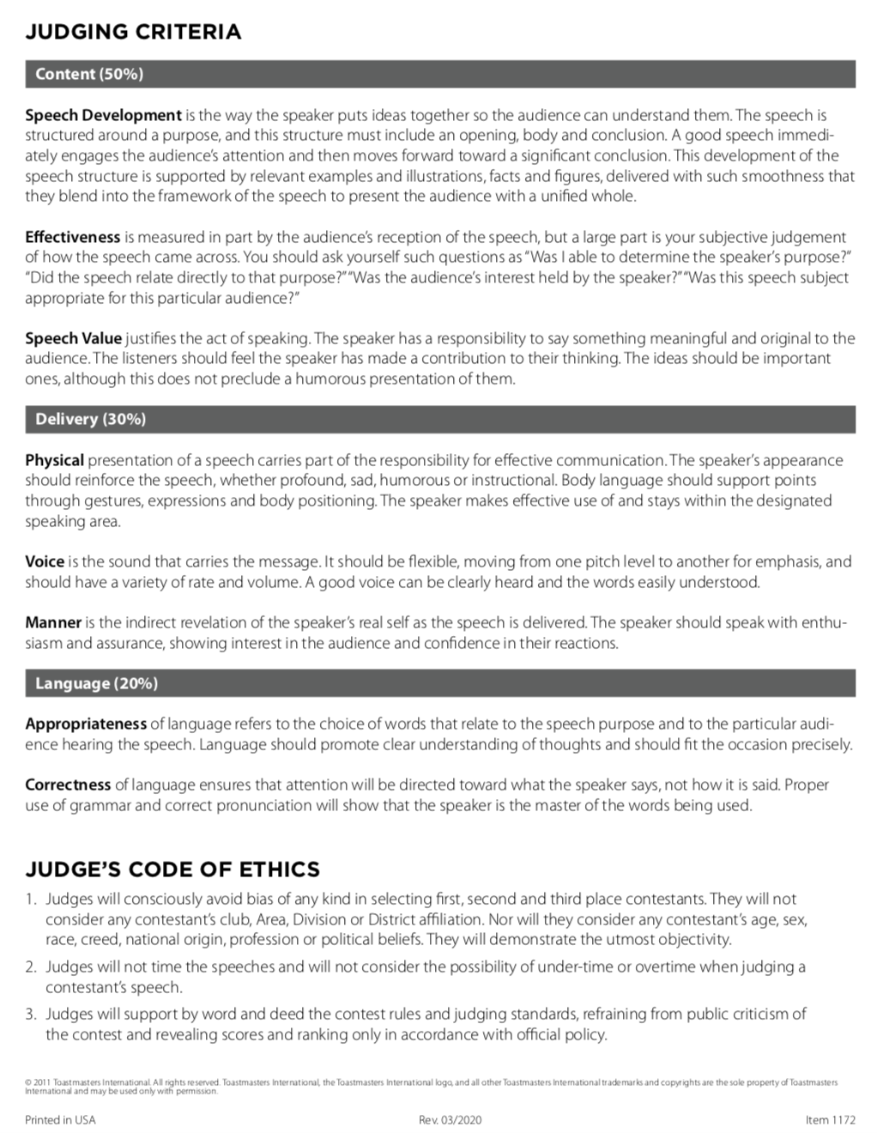
Example Ballot and Judging Criteria

Slide 10
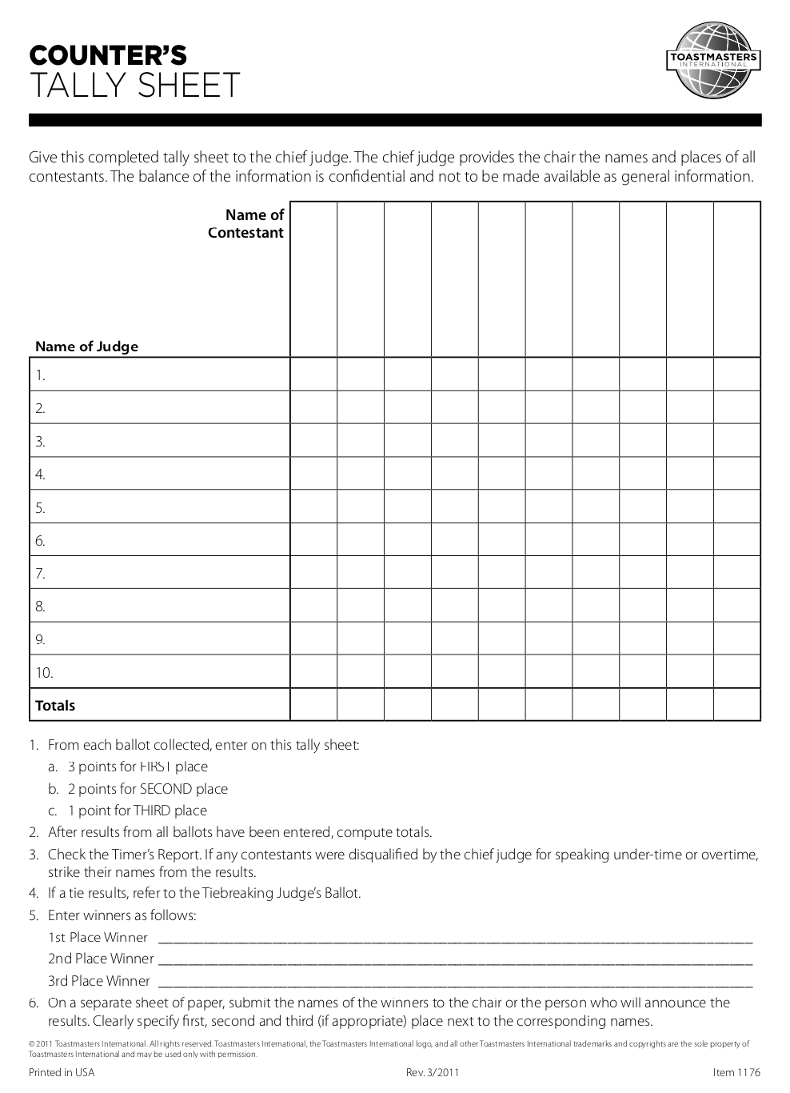
Ballot Counters
Ballot counters will complete form 1176 Counter’s Tally Sheet
If tie, consult Chief Judge who will look at the tiebreaking ballot to break the tie
Send tally sheet to Chief Judge
Chief judge will notify Contest Chair of winner (see next slide)
Once complete, the judges and ballot counters may leave the breakout room and return to the main meeting

Slide 11
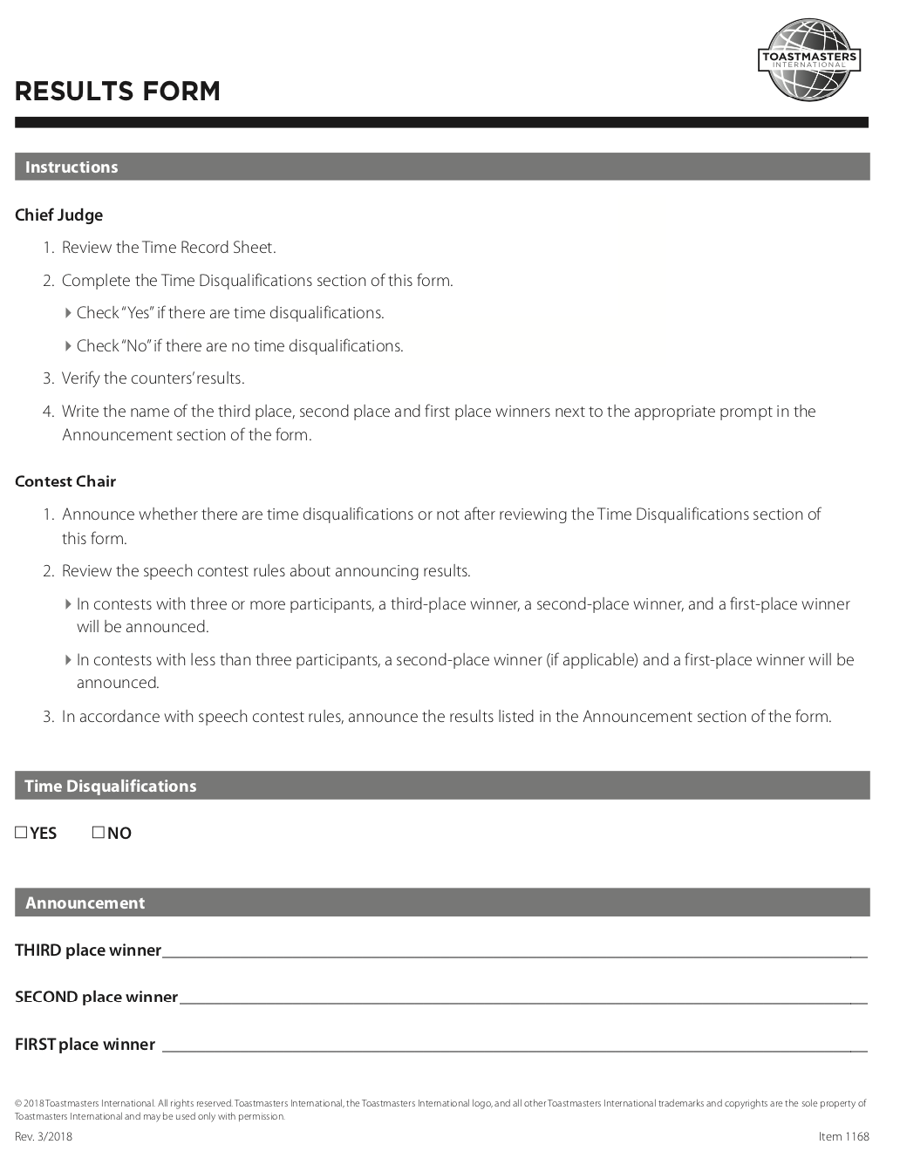
Notification of Winner
Chief judge will determine if any time disqualifications
Chief judge will verify the counter’s results
Chief judge will summarize third place, second place and first place results from tally sheet on form 1168 Results Form
Chief judge will message picture of form 1168 Results Form to Contest Chair, and confirm message sent via Zoom chat
Once complete, the judges and ballot counters may leave the breakout room and return to the main meeting
Contest Chair will announce the winners of both contests at the end of the meeting
Contest chair will send 1182 Notification of Contest Winner to the contest chair of the Area contest.

Slide 12
Zoommaster
Person doing the breakout room must have “host” privileges
Breakout rooms are “all or nothing”, if more than 1 created, they open and close simultaneously
Brief participants on zoom rules and breakout sessions
Setup 2 breakout session at beginning
1 Contest chair and contestants (consult contest chair as this might not be needed)
1 Chief judge, Judges, timers, and ballot counters
If possible mute all but contestant during speeches, and have audience turn off cameras, and hide non-video participants if contestant doesn’t pin timer, the time is still viewable without distractions
Zoommaster could use the “spotlight” feature on contestants when they are speaking
Zoommaster could use the “spotlight” feature on both the contest chair and each contestant simultaneously during the 1-on-1 interviews after each speech contest.
Applause sound would be great at end of speeches and when winners are announced
Be prepared to mute any late entrants to the meeting to avoid disruption
Setup breakout session after each contest, for judges and ballot counters (timers upon request)

